Slide 1
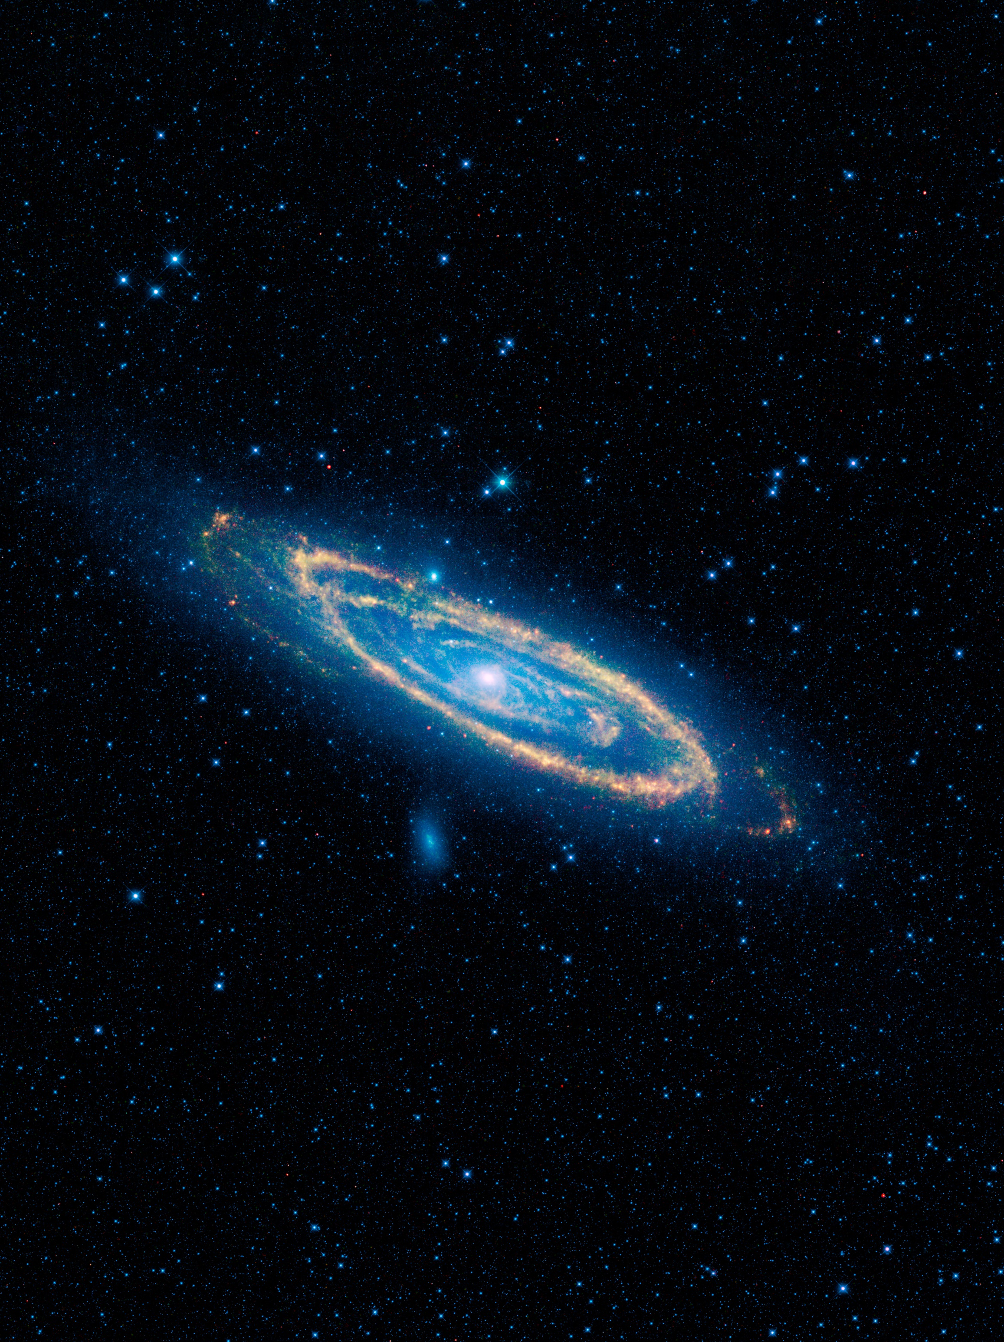
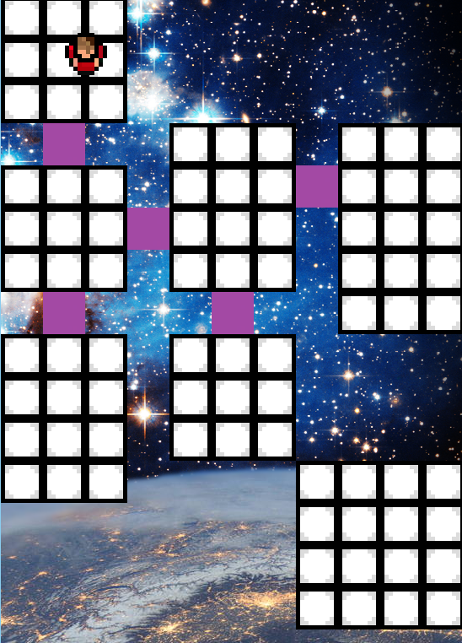
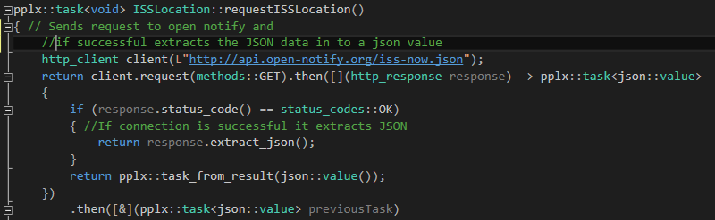
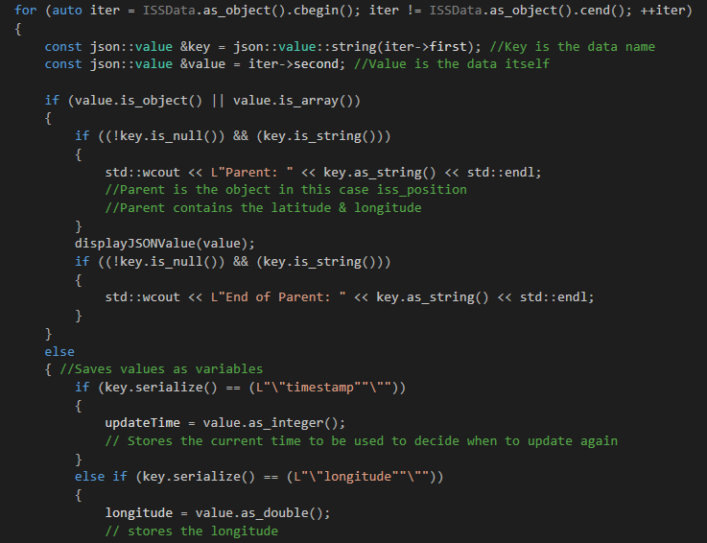
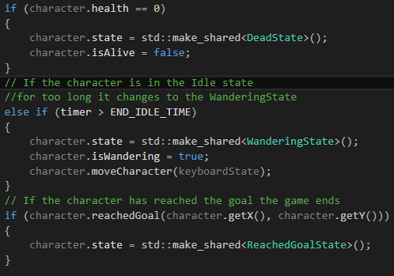
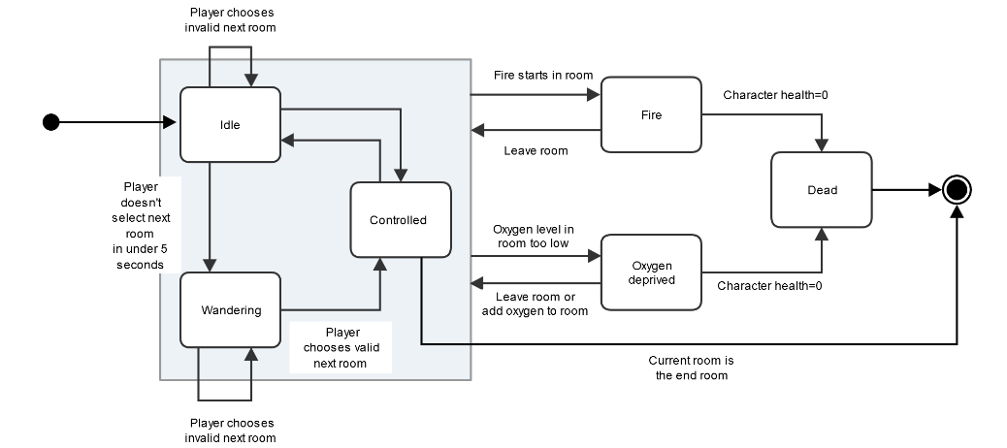
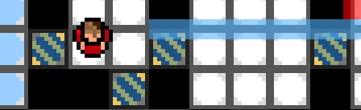
Character AI & Updating Background
Both of the components are integrated into the COMP150 group game. The first is using an API to update the game background based on the location of the ISS. The second is an AI for the character in the game to make it respond to its environment and player input.
Updating Background:
This component uses the Open Notify API to get the location of the International Space Station. Using Open Notify to get a JSON object and the C++ REST SDK, the code extracts the time and the coordinates from the JSON object and moves the background accordingly. The function returns a pplx::task which allows the data to be extracted in the background and not force the program to wait.
Requests ISS location from Open Notify
Extracts the JSON data
Saves JSON values as variables
Variables are then used to calculate new X and Y positions for background
Character AI:
The character AI uses the State design pattern to change the character’s behaviour depending on the environment.
Checks if the character is dead
Checks if the character is ready to start wandering
All the states inherit from CharacterState and using polymorphism they all have an update function. The update function checks the characters health and position to decide which state it should be in. For example if the character’s health reaches 0 they enter the DeadState.
Checks if the character has reached the end of the level

